Slide 1



Welcome to Sutter Health CPMC’s

Slide 2


Paddington 2
Saturday, Sept 22nd
Upper Noe Valley Rec. Center

Slide 3
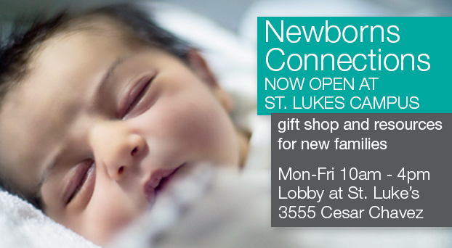


Slide 4

NOW OPEN
Pediatric After Hours Care at Valencia and Cesar Chavez

Slide 5
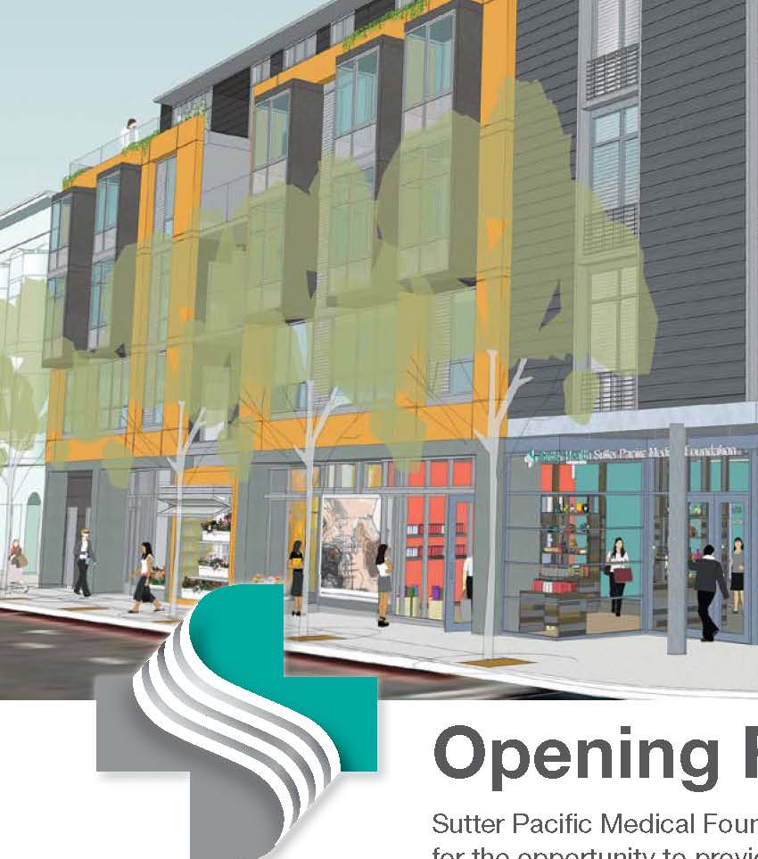

Now Open
SPMF Valencia Street Care Center
899 Valencia St at 20th St
Services:
adult and pediatric primary care
lab and imaging
integrative health

Slide 6
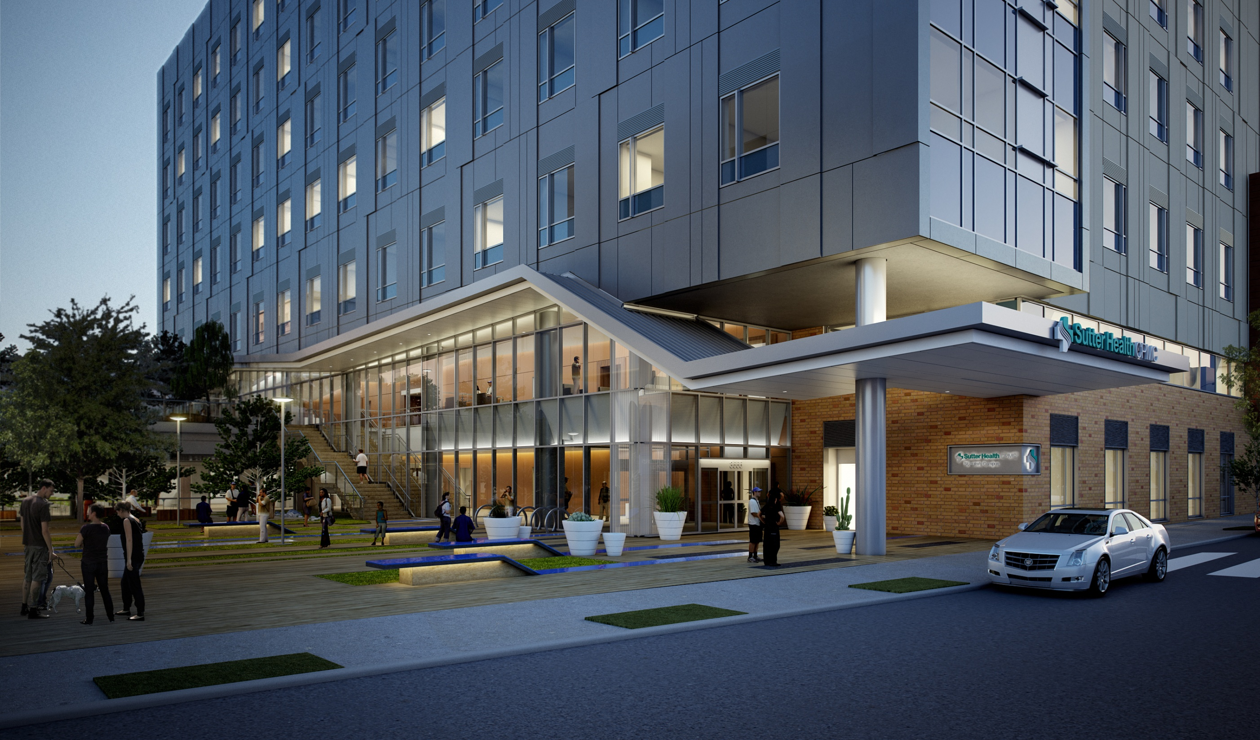
New Hospital at Valencia & Cesar Chavez
Now Open!

Slide 7
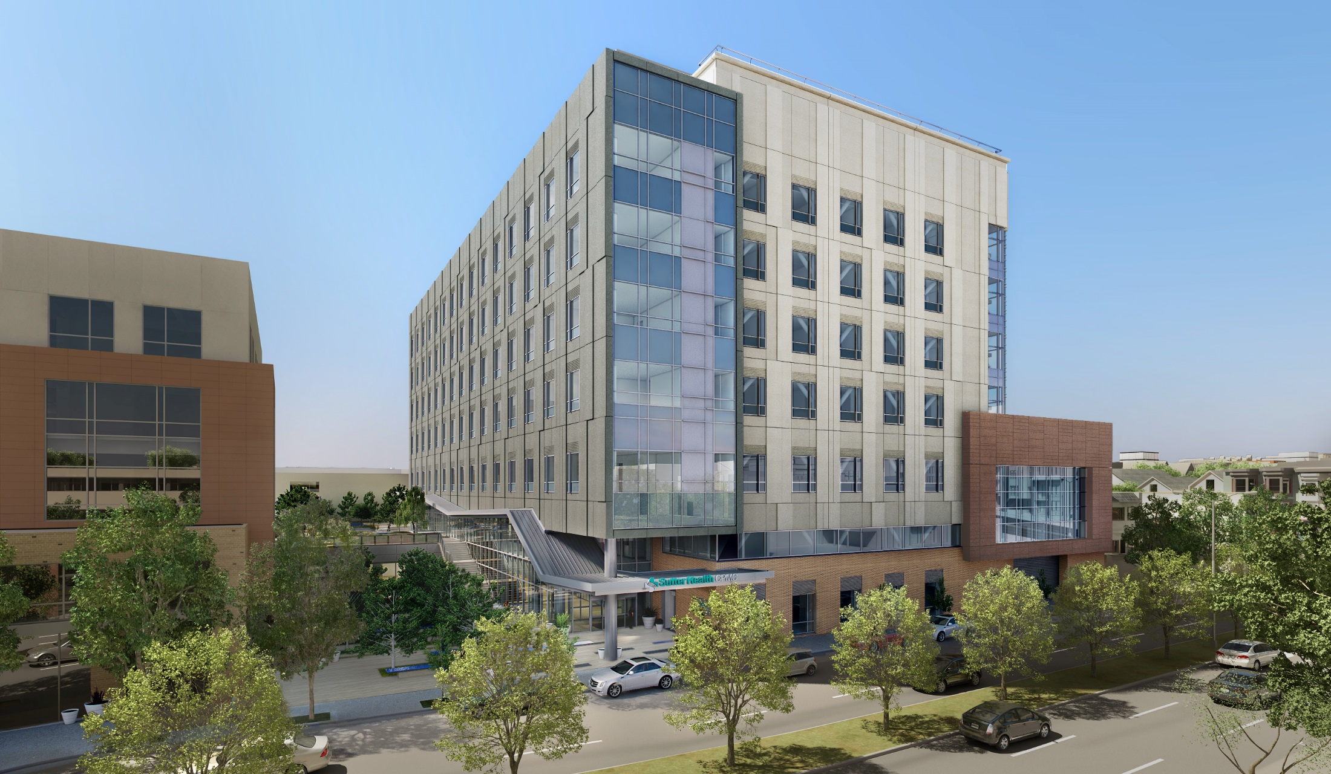
New Hospital at Valencia & Cesar Chavez
Now Open!

Slide 8
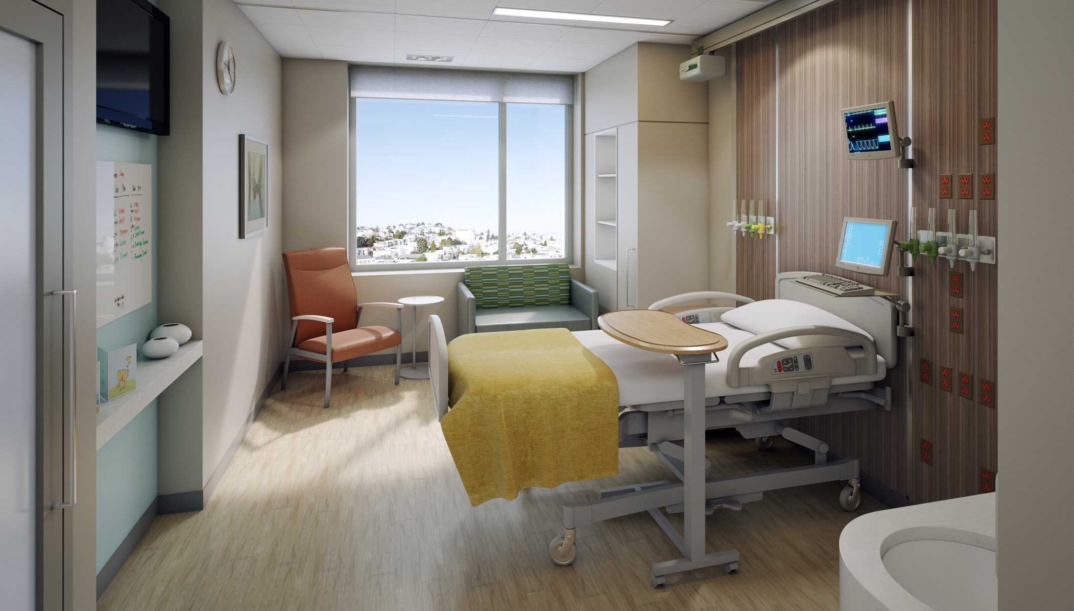
New Hospital at Valencia & Cesar Chavez
Now Open!

Slide 9
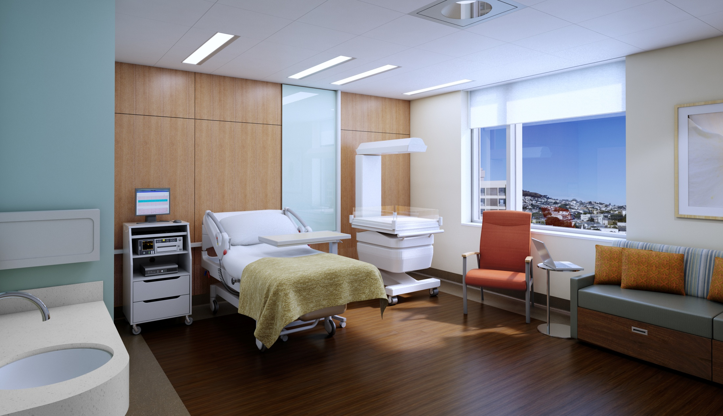
New Hospital at Valencia & Cesar Chavez
Now Open!

Slide 10
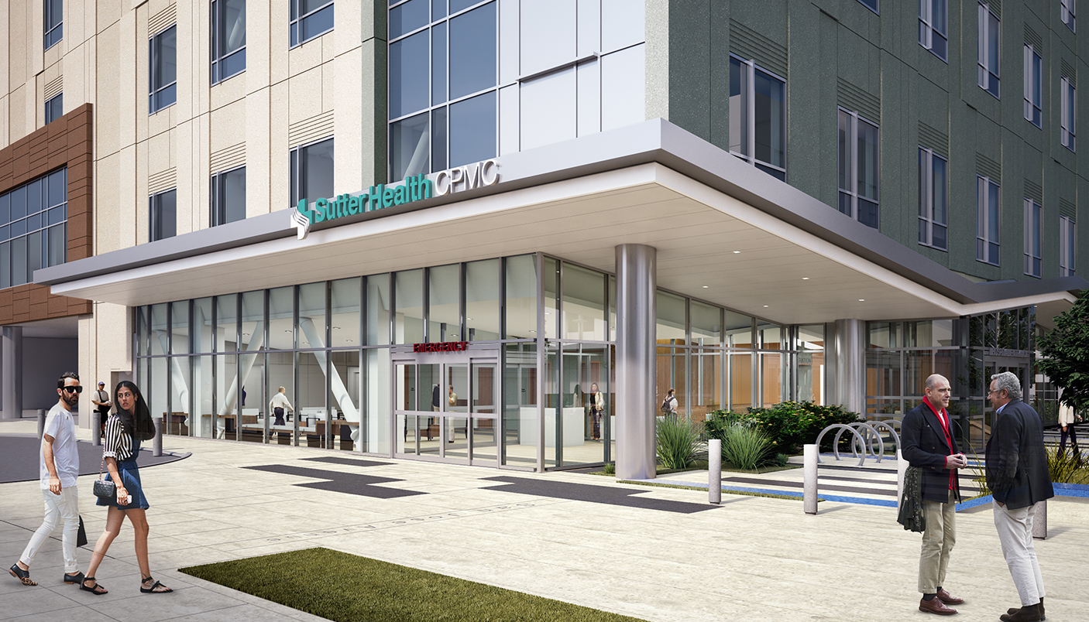
New Hospital at Valencia & Cesar Chavez
Now Open!

Slide 11
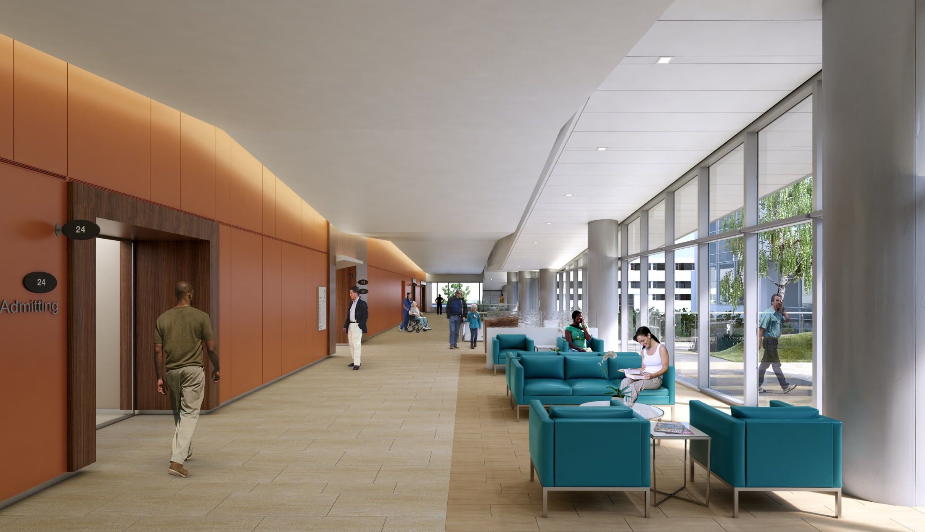
New Hospital at Valencia & Cesar Chavez
Now Open!

Slide 12

Please respect the park and dispose of all trash.

Slide 13

Portable restrooms are provided along the park for your convenience.

